Slide 1
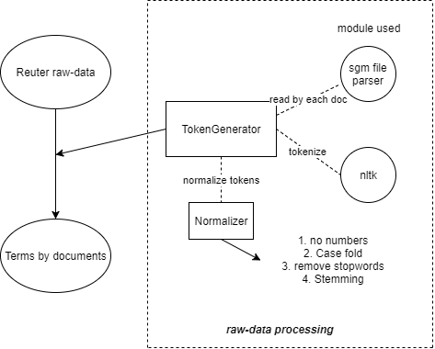
Comp 6791 Project 1 System Overview
Raw-data processing
Xingjian Zhang
40010222

Slide 2
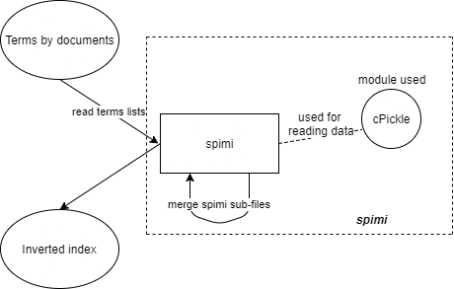
Comp 6791 Project 1 System Overview
SPIMI --- Inverted index generation

Slide 3
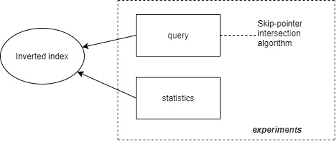
Comp 6791 Project 1 System Overview
Make queries
Single word -> Refer to terms list
Multi keywords:
“AND”--------> Intersecting with skip pointers
“OR” --------> Union

